Slide 1
Fashion Through Time

Slide 2
The Evolution of Fashion: A Historical Perspective
Explore the intricate journey of fashion from the Victorian era to the present, highlighting the iconic styles and influencers that shaped each decade.

Slide 3
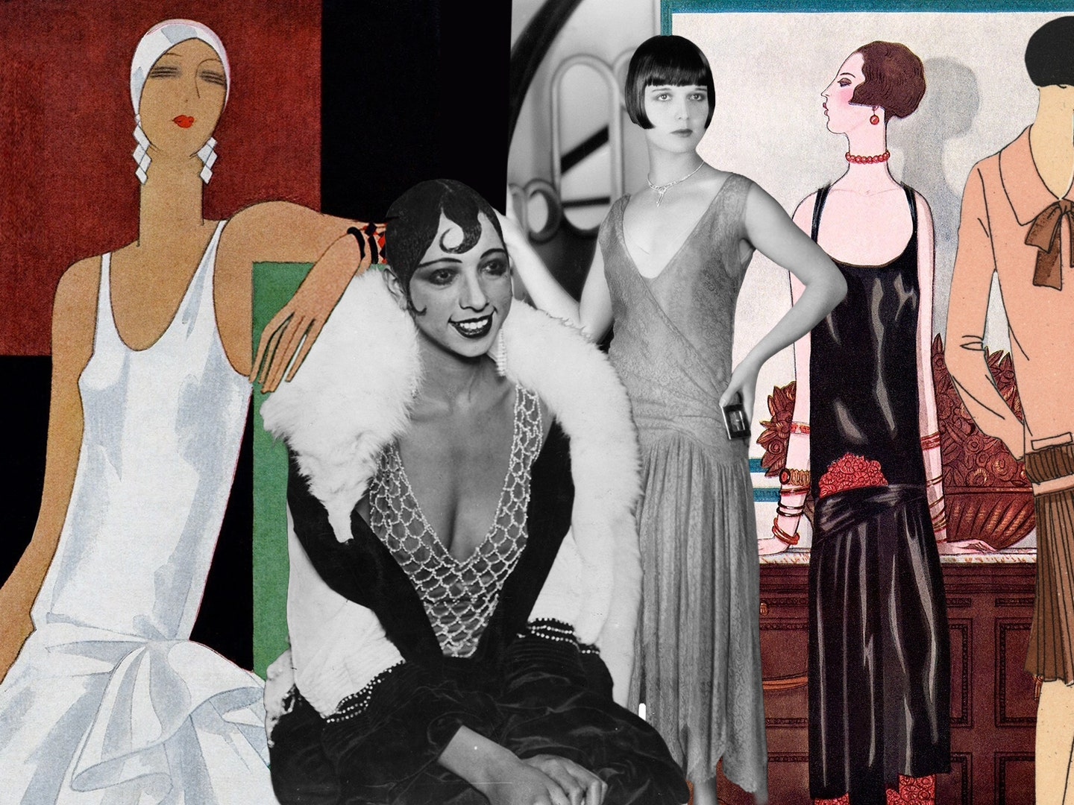

Slide 4
Fashion Icons & Their Influence
Delve into the impact of fashion icons like Coco Chanel, Audrey Hepburn, and contemporary influencers. Examine their role in shaping trends and their lasting impact on the industry.

Slide 5
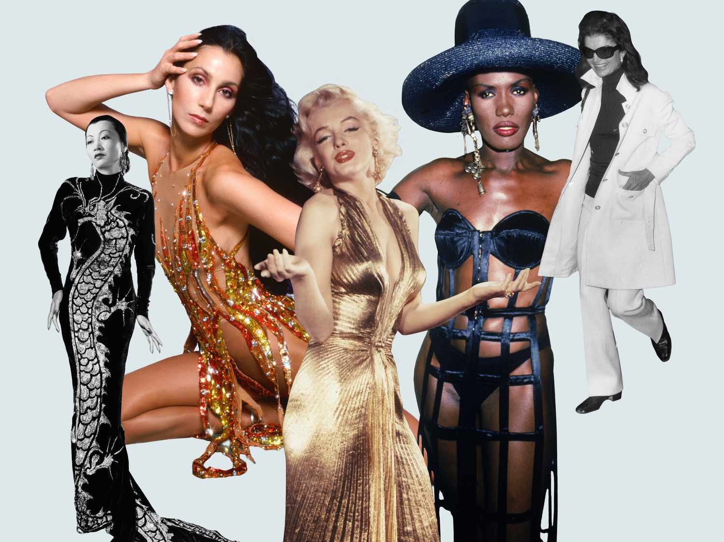

Slide 6
The Runway: A Showcase of Creativity
Take a front-row seat at the fashion runway. Explore the latest trends, breathtaking designs, and the creative vision behind them.

Slide 7
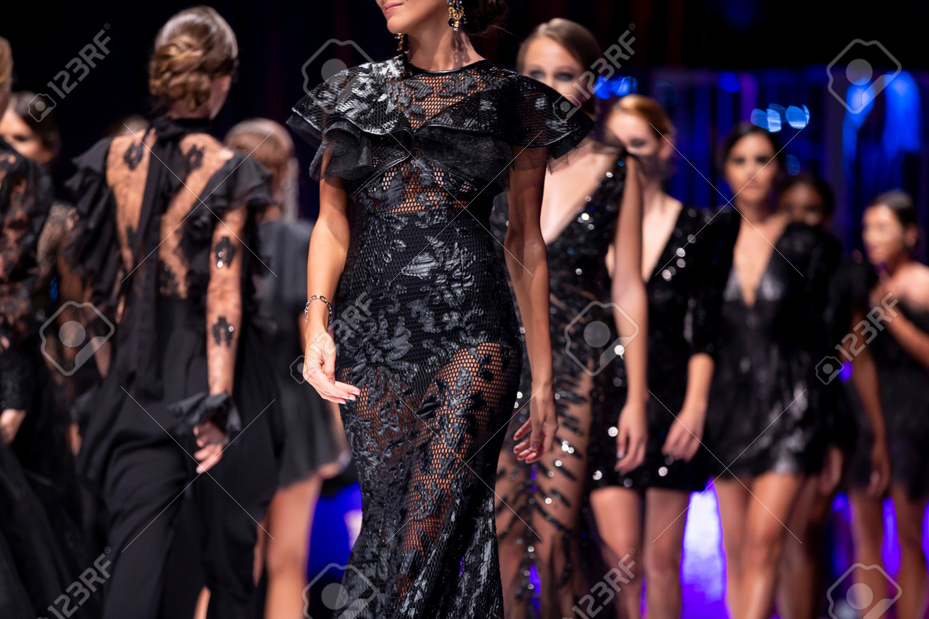

Slide 8
Fashion Capital of the World
Dive into the heart of the fashion capital, Paris. Discover the vibrant fashion scene, renowned design houses, and the city's timeless influence on style.

Slide 9
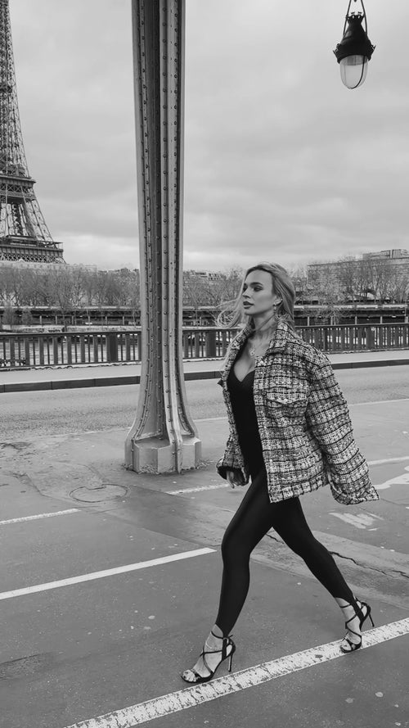

Slide 10
Street Style
Explore the phenomenon of street style and the unique, individual expressions of fashion found on the streets of global fashion hubs.

Slide 11
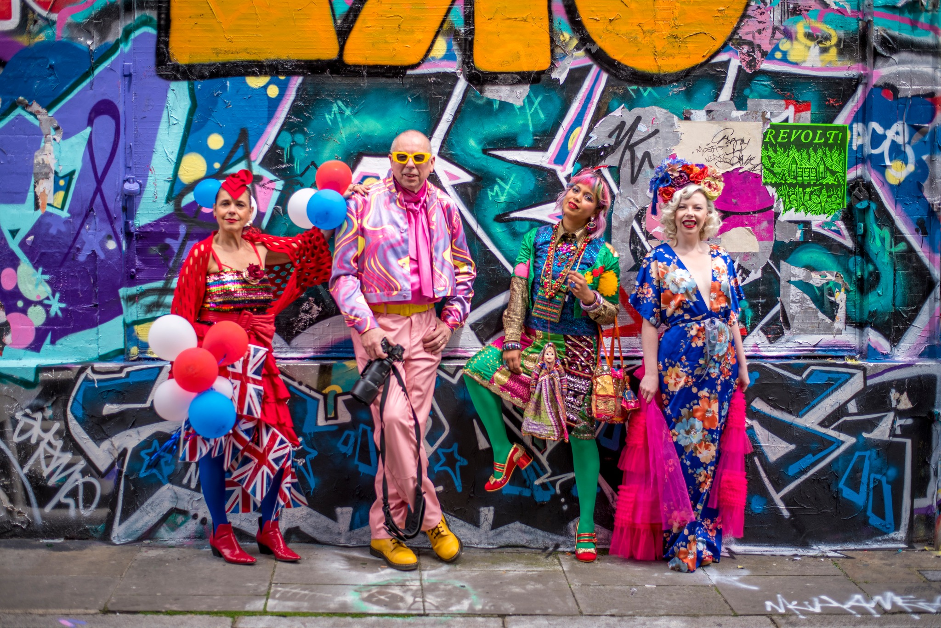

Slide 12
The Business of Fashion
Understand the business aspects of the fashion world, including branding, marketing strategies, and the impact of globalization.

Slide 13
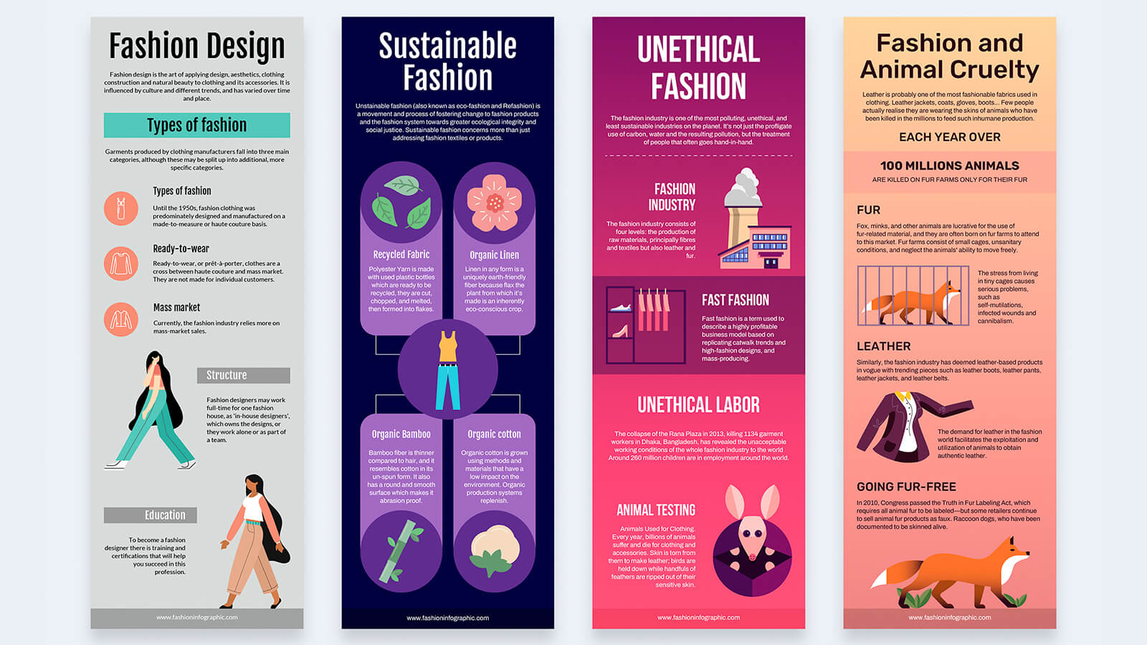

Slide 14
Conclusion

